Slide 1
Trees

Slide 2
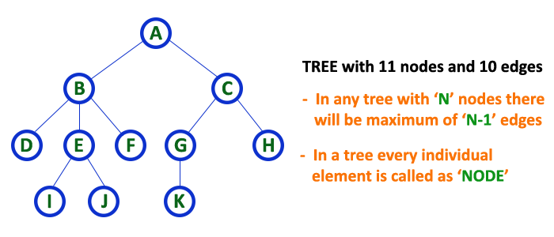

Slide 3
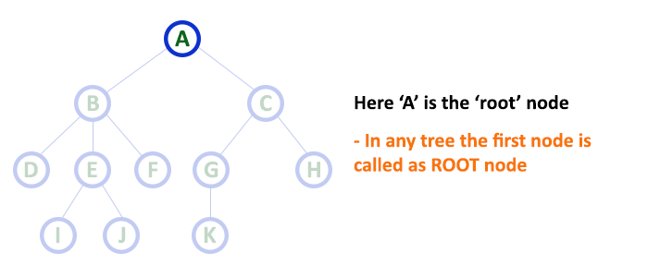
Root
In a tree data structure, the first node is called as Root Node. Every tree must have a root node. We can say that the root node is the origin of the tree data structure. In any tree, there must be only one root node. We never have multiple root nodes in a tree

Slide 4
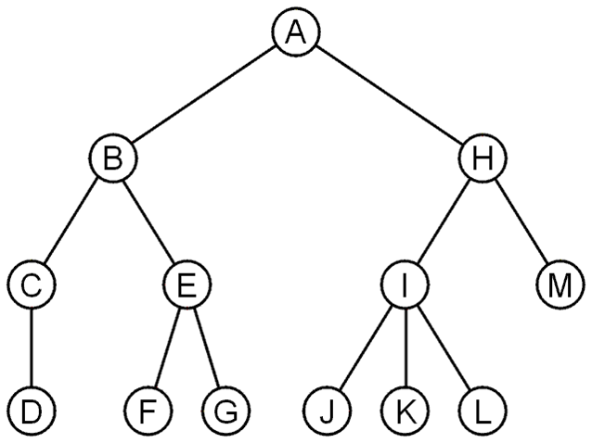
A rooted tree data structure stores information in nodes
  Similar to linked lists:
    There is a first node, or root
    Each node has variable number of references to successors
    Each node, other than the root, has exactly one node pointing to it

Slide 5
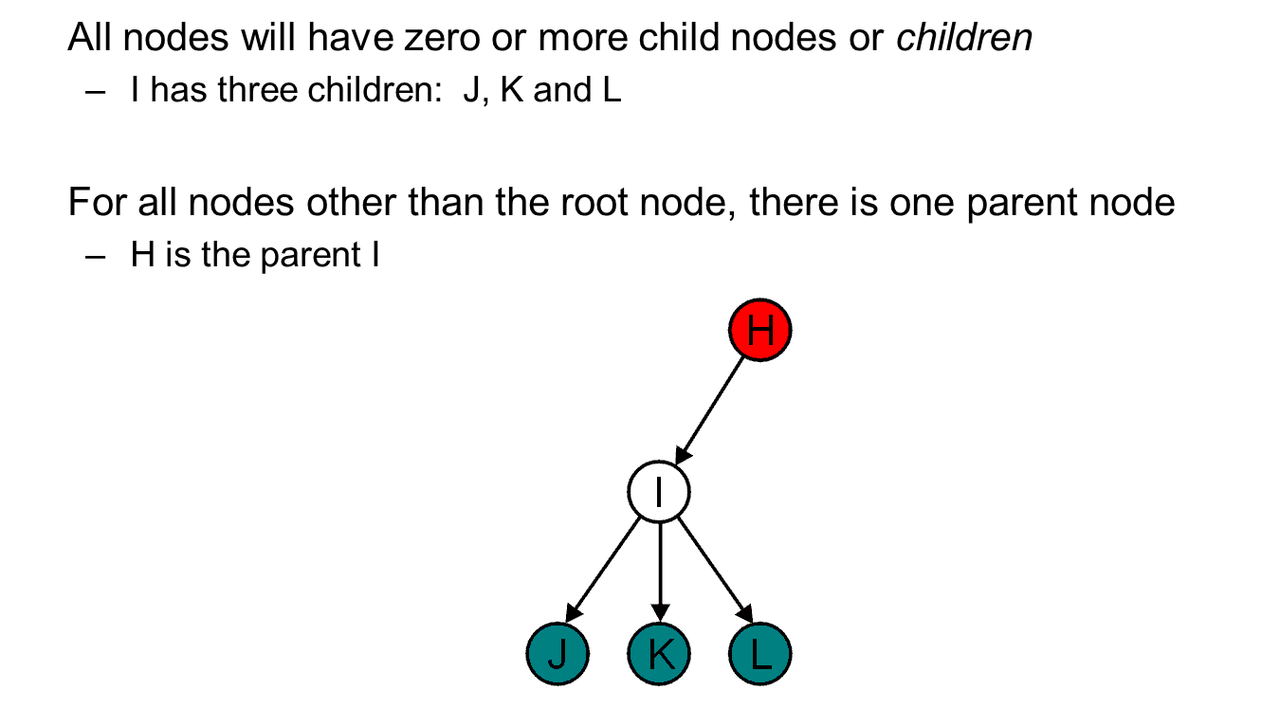

Slide 6
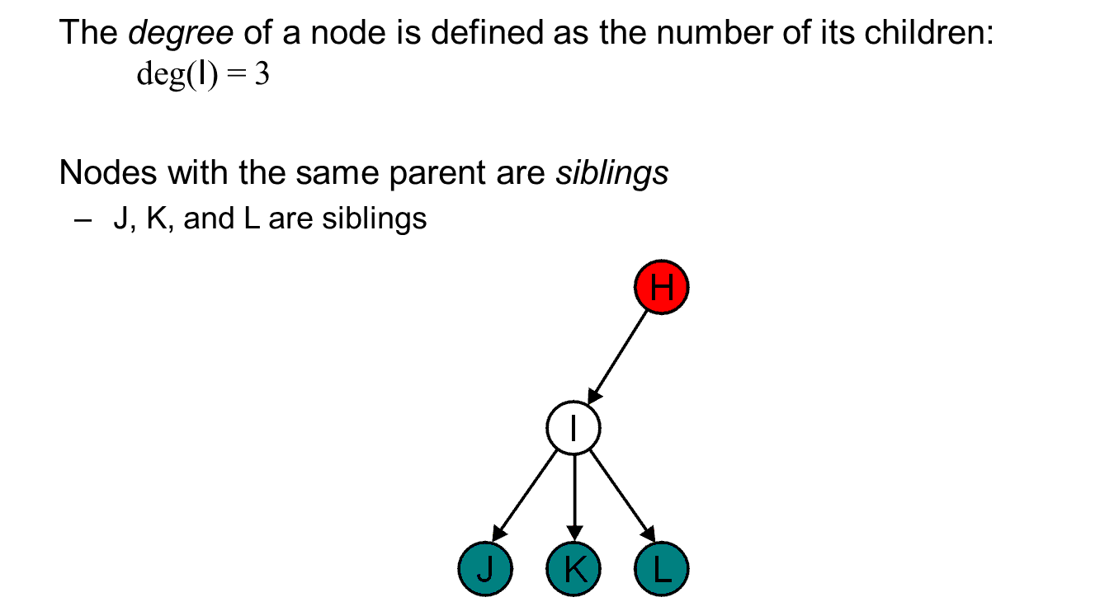

Slide 7
Leaf
In a tree data structure, the node which does not have a child is called as LEAF Node. In simple words, a leaf is a node with no child.
In a tree data structure, the leaf nodes are also called as External Nodes. External node is also a node with no child. In a tree, leaf node is also called as 'Terminal' node.
Internal Nodes
In a tree data structure, the node which has atleast one child is called as INTERNAL Node. In simple words, an internal node is a node with atleast one child.
In a tree data structure, nodes other than leaf nodes are called as Internal Nodes. The root node is also said to be Internal Node if the tree has more than one node. Internal nodes are also called as 'Non-Terminal' nodes.

Slide 8
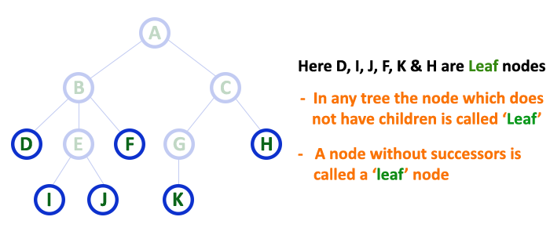
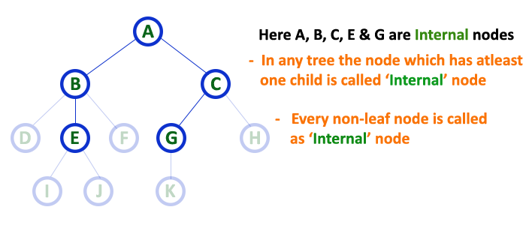

Slide 9
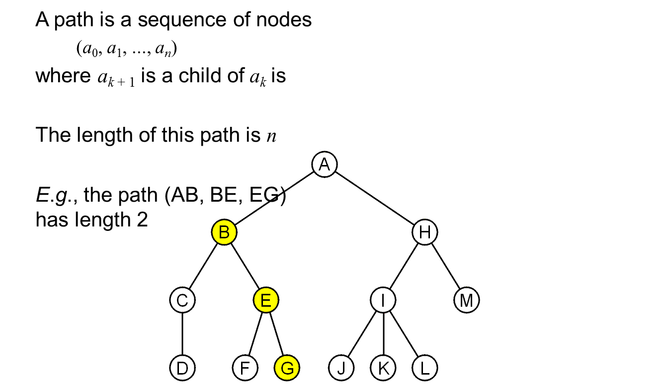
Edge
In a tree data structure, the connecting link between any two nodes is called as EDGE. In a tree with 'N' number of nodes there will be a maximum of 'N-1' number of edges.

Slide 10
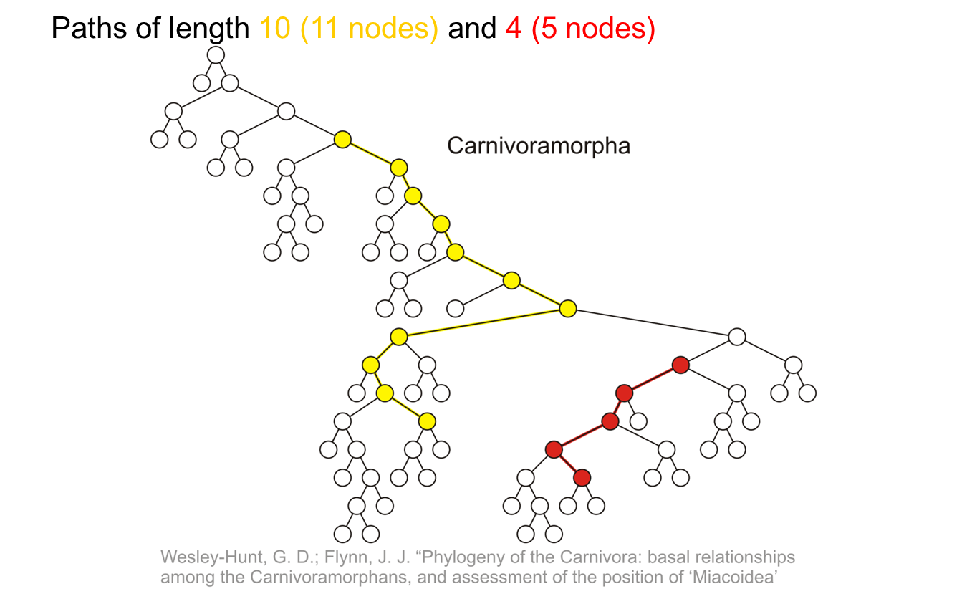

Slide 11
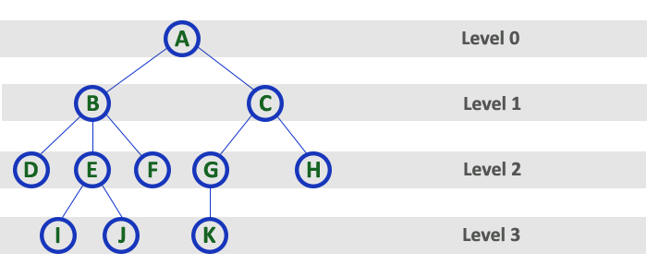
Level
In a tree data structure, the root node is said to be at Level 0 and the children of root node are at Level 1 and the children of the nodes which are at Level 1 will be at Level 2 and so on... In simple words, in a tree each step from top to bottom is called as a Level and the Level count starts with '0' and incremented by one at each level (Step).

Slide 12
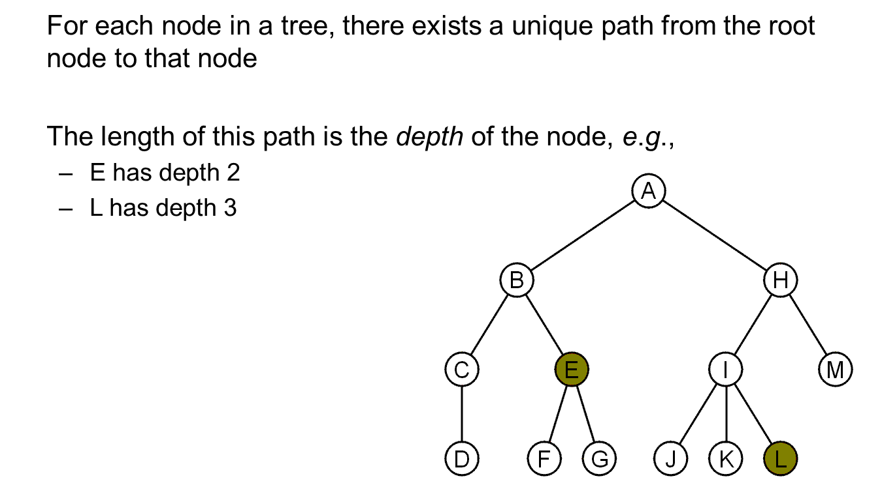

Slide 13
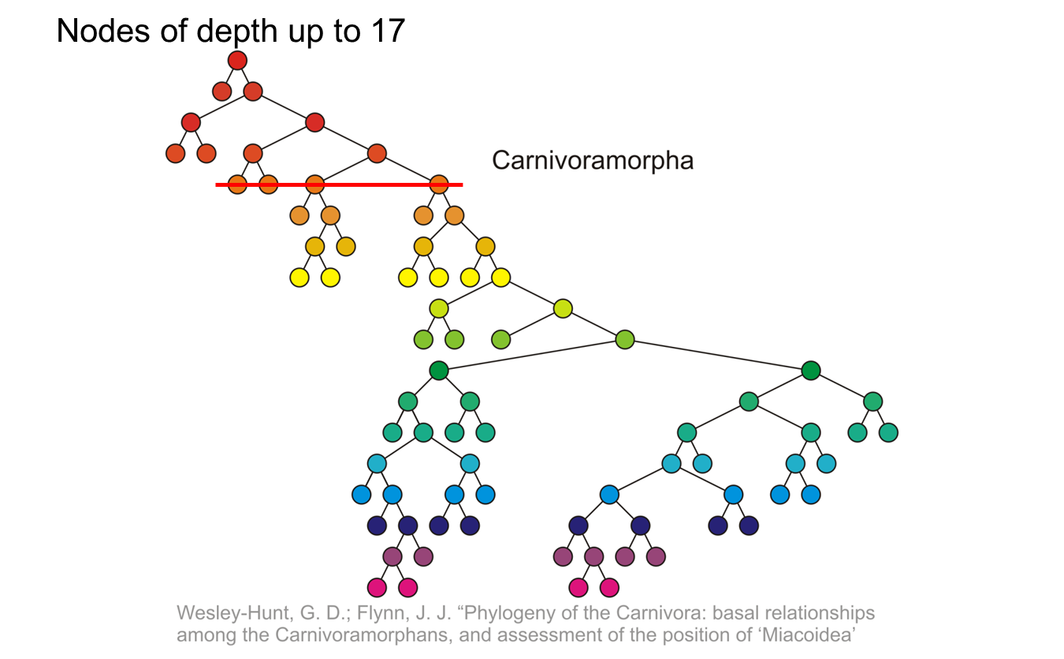

Slide 14
The height of a tree is defined as the maximum depth of any node within the tree
The height of a tree with one node is 0
  Just the root node
For convenience, we define the height of the empty tree to be –1

Slide 15
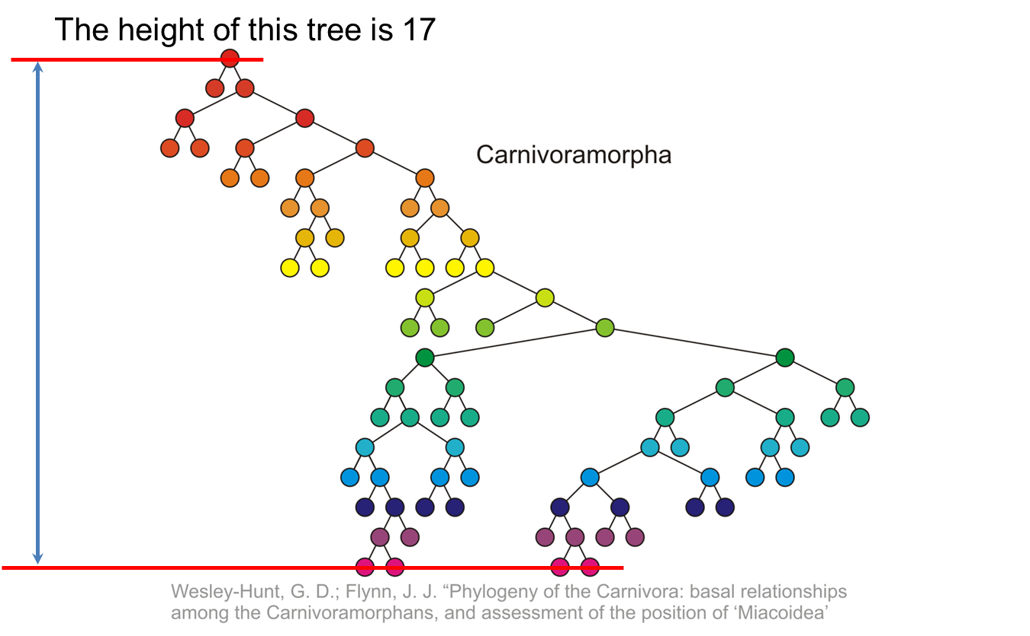

Slide 16
If a path exists from node a to node b:
  a is an ancestor of b
  b is a descendent of a
Thus, a node is both an ancestor and a descendant of itself
  We can add the adjective strict to exclude equality: a is a strict descendent of b if a is a descendant of b but a ≠ b
The root node is an ancestor of all nodes

Slide 17
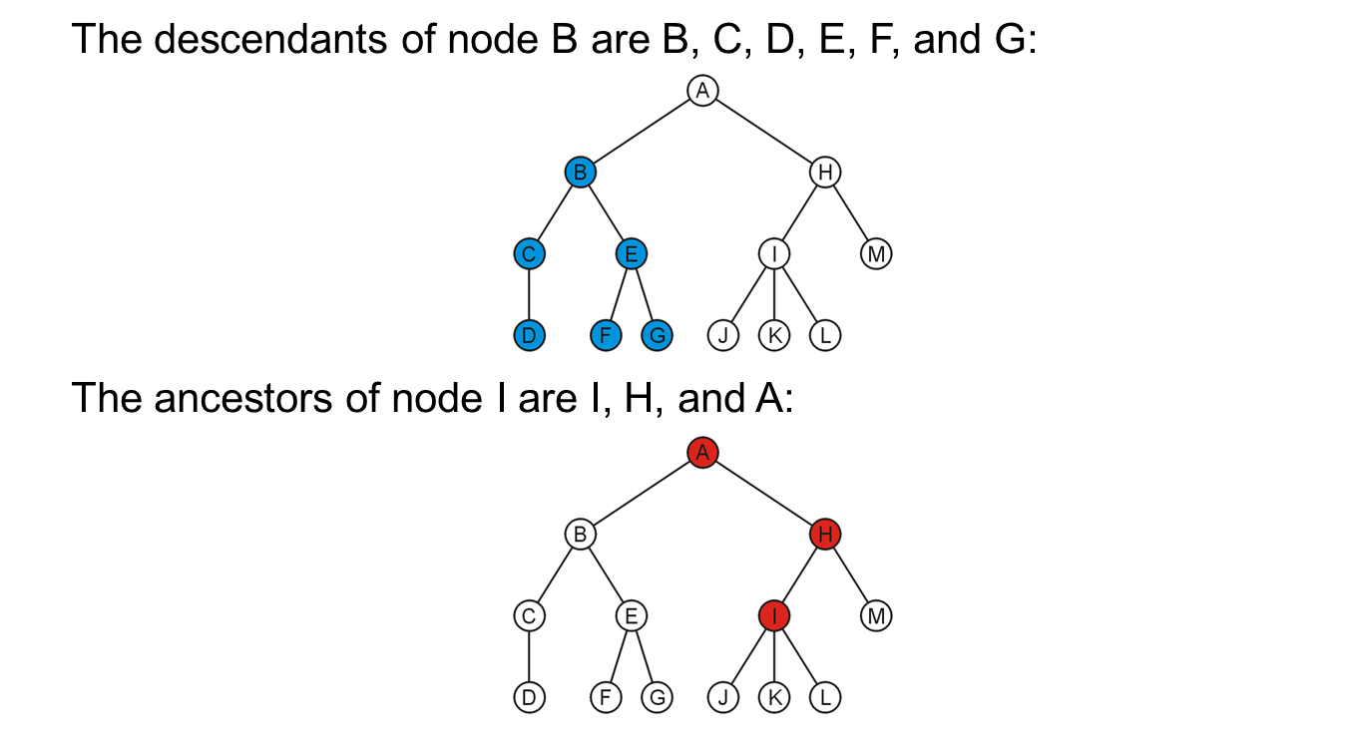

Slide 18
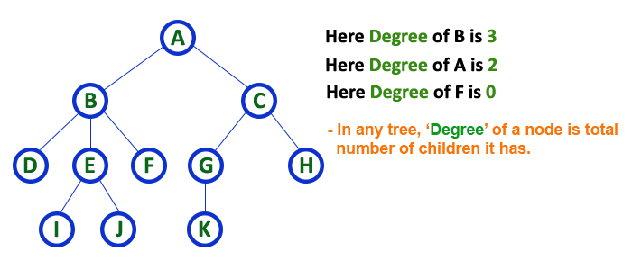
Degree
In a tree data structure, the total number of children of a node is called as DEGREE of that Node. In simple words, the Degree of a node is total number of children it has. The highest degree of a node among all the nodes in a tree is called as 'Degree of Tree'

Slide 19
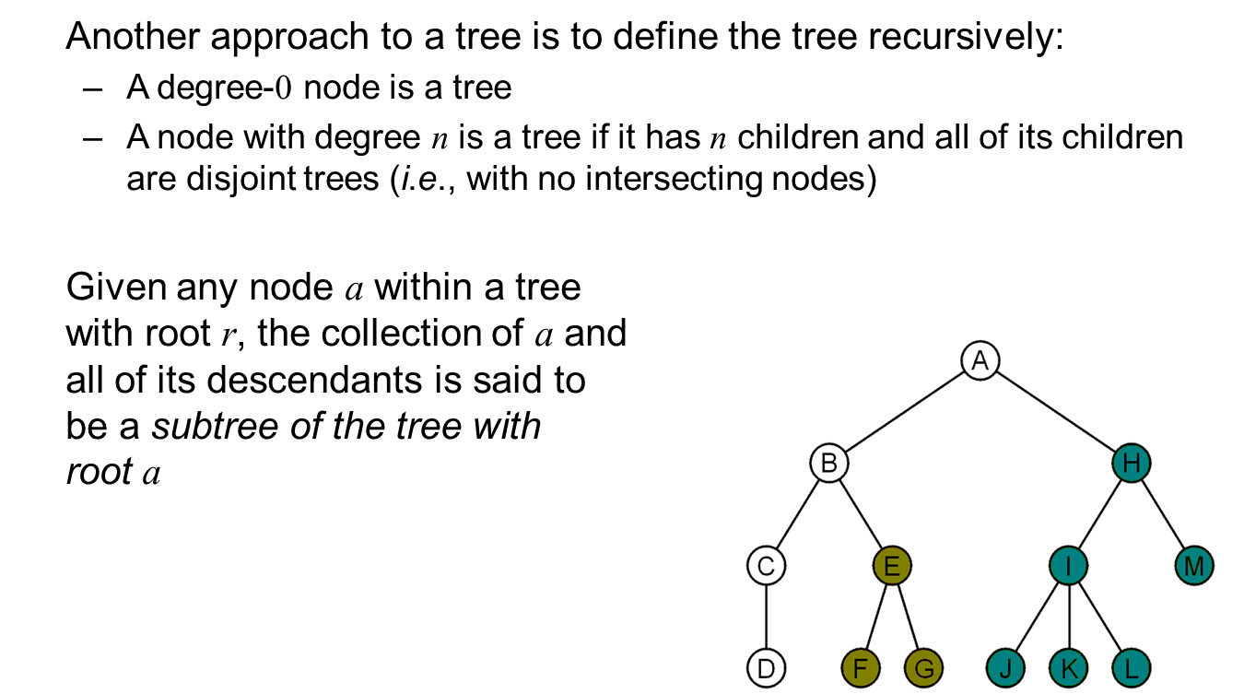

Slide 20
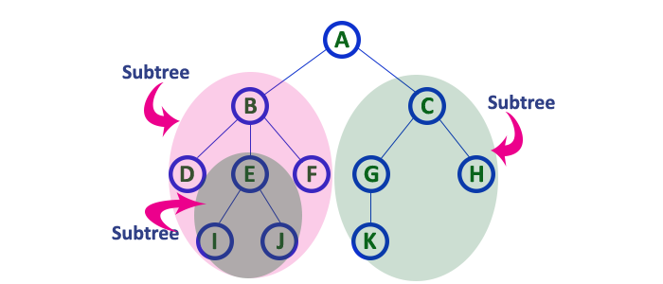
Sub Tree
In a tree data structure, each child from a node forms a subtree recursively. Every child node will form a subtree on its parent node.

Slide 21
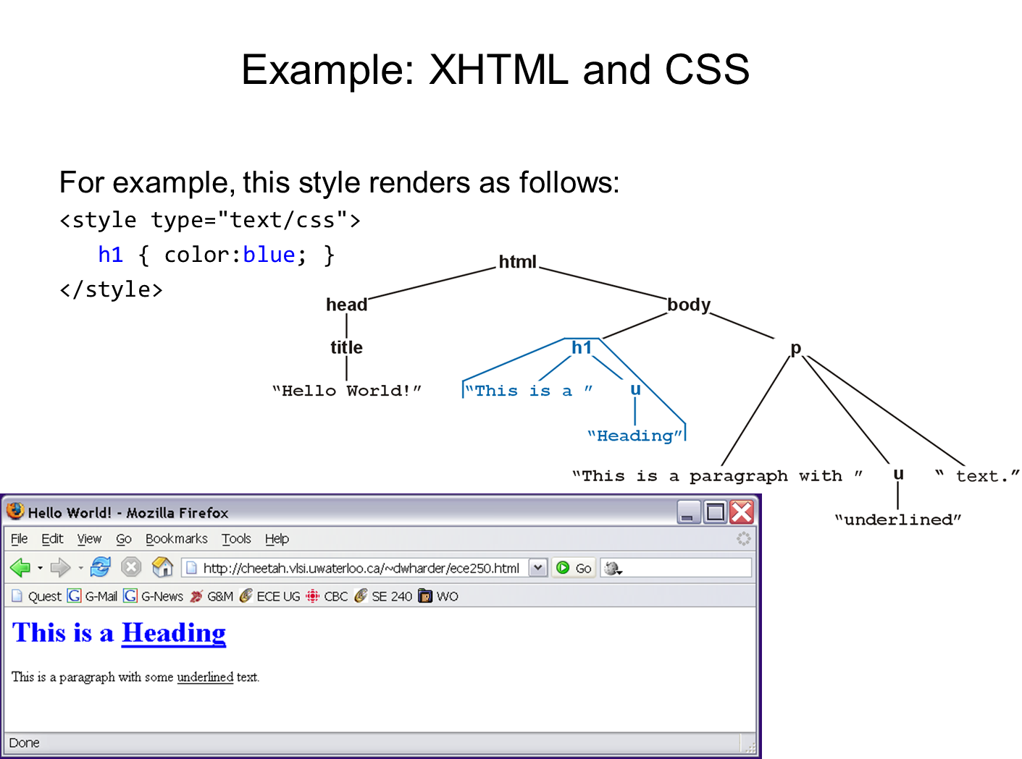

Slide 22
Tree terminology cont--
Nodes: A, B, …, F
Root node: A
Leaf nodes: B, E, F, D
Edges: (A,B), (A,C), …, (C, F)
Path: sequence of nodes connected by edges.
Path examples: (AB),(AC),(AD), (AC,CE), (AC,CF), (CE,CF)
A
B
C
D
E
F
Questions. A tree has N nodes.
How many edges does it have ? How many paths ?

Slide 23
Length of a path = number of edges
Depth of a node x = length of path from root to x
Height of node x = length of longest path from x to a leaf
Depth and height of tree = height of root
The label of a node: A, B, C, …
depth=0, height = 2
A
B
C
D
depth = 2, height=0
E
F

Slide 24
Definition
A tree is a collection of elements called nodes, one of which is distinguished as a root, along with a relation ("parenthood") that places a hierarchical structure on the nodes.
A node, like an element of a list, can be of whatever type we wish. We often depict a node as a letter, a string, or a number with a circle around it. Formally, a tree can be defined recursively in the following manner.
1. A single node by itself is a tree. This node is also the root of the tree.
2. Suppose n is a node and T1, T2, . . . , Tk are trees with roots n1, n2, . . . , nk, respectively. We can construct a new tree by making n be the parent of nodes n1, n2, . . . , nk. In this tree n is the root and T1, T2, . . . , Tk are the subtrees of the root. Nodes n1, n2, . . . , nk are called the children of node n.

Slide 25
Definition
If there is a path from node a to node b, then a is an ancestor of b, and b is a descendant of a.
An ancestor or descendant of a node, other than the node itself, is called a proper ancestor or proper descendant, respectively.
In a tree, the root is the only node with no proper ancestors. A node with no proper descendants is called a leaf.
A subtree of a tree is a node, together with all its descendants.
The height of a node in a tree is the length of a longest path from the node to a leaf.

Slide 26
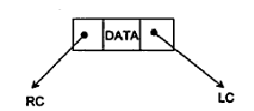
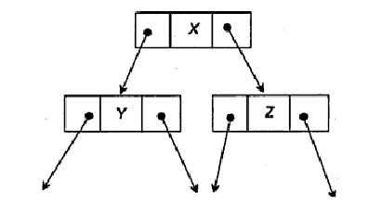
Implementation of Trees
A
B
C
D
E
F

Slide 27
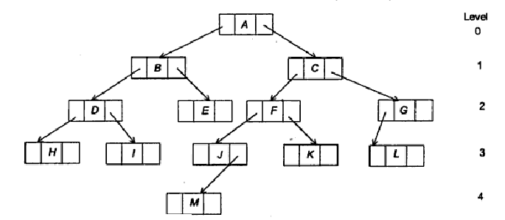
Binary trees
A binary tree is an important type of tree structure which occurs very often. It is characterized by the fact that any node can have at most two branches, i.e., there is no node with degree greater than two.
For binary trees we distinguish between the subtree on the left and on the right, whereas for trees the order of the sub trees was irrelevant. Also a binary tree may have zero nodes.

Slide 28
A binary tree may also be defined as follows:
A binary tree is either an empty tree
Or a binary tree consists of a node called the root node, a left subtree and a right subtree, both of which will act as a binary tree once again.
Applications : Binary trees are used to represent a nonlinear data structure. There are various forms of Binary trees. Binary trees play a vital role in a software application. One of the most important applications of the Binary tree is in the searching algorithm

Slide 29
Application: Arithmetic Expression Trees
Example Arithmetic Expression:
A + (B * (C / D) )
Tree for the above expression:
+
A
*
Used in most compilers
No parenthesis need – use tree structure
Can speed up calculations e.g. replace
/ node with C/D if C and D are known
Calculate by traversing tree (how?)
B
/
C
D

Slide 30
Traversing Trees
Preorder: Root, then Children
  + A * B / C D
Postorder: Children, then Root
  A B C D / * +
Inorder: Left child, Root, Right child
  A + B * C / D
+
A
*
B
/
C
D

Slide 31
Example Code for Recursive Preorder
void print_preorder ( TreeNode T)
{ if ( T == NULL ) return;
print_element(T.Element());
print_preorder(T.FirstChild());
print_preorder(T.NextSibling());
}
What is the running time for a tree with N nodes?

Slide 32
PreOrder traversal - visit the parent first and then left and right children;
InOrder traversal - visit the left child, then the parent and the right child;
PostOrder traversal - visit left child, then the right child and then the parent;

Slide 33

Binary Trees
Properties
  max # of leaves = 2^{depth(tree)}
  max # of nodes = 2^{depth(tree)+1} – 1
We care a lot about the depth:
  max depth = n-1
  min depth = log(n)
  average depth for n nodes =
  (over all possible binary trees)
Representation:
A
B
C
D
E
F
G
H
TreeNode: | Element
 | Left | Right
I
J
Notes:
Alright, we’ll focus today on one type of trees called binary trees.
Here’s one now.
Is this binary tree complete?
Why not?
(C has just one child, right side is much deeper than left)
What’s the maximum # of leaves a binary tree of depth d can have?
What’s the max # of nodes a binary tree of depth d can have?
Minimum?
We won’t go into this, but if you take N nodes and assume all distinct trees of the nodes are equally likely, you get an average depth of SQRT(N).
Is that bigger or smaller than log n?
Bigger, so it’s not good enough!

Slide 34
Binary Trees
Notice:
we distinguish between left child and right child
A
A
B
C
≠
B
C
F
F
G
H
G
H

Slide 35
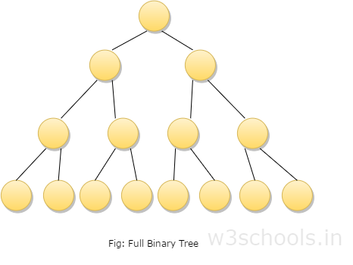
Types of Binary Trees
A full binary tree which is also called as proper binary tree or 2-tree is a tree in which all the node other than the leaves has exact two children.

Slide 36
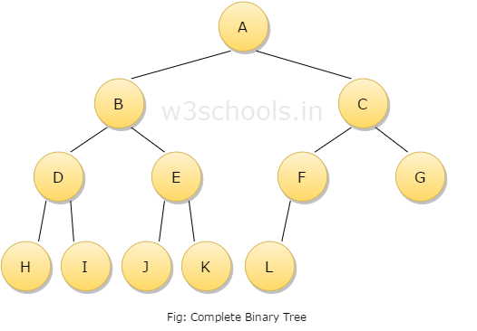
A complete binary tree is a binary tree in which at every level, except possibly the last, has to be filled and all nodes are as far left as possible.

Slide 37
A binary tree can be converted into an extended binary tree by adding new nodes to its leaf nodes and to the nodes that have only one child. These new nodes are added in such a way that all the nodes in the resultant tree have either zero or two children. It is also called 2 - tree.
The threaded Binary tree is the tree which is represented using pointers the empty subtrees are set to NULL, i.e. 'left' pointer of the node whose left child is empty subtree is normally set to NULL. These large numbers of pointer sets are used in different ways.

Slide 38
Binary Search Tree
Search tree property
  all keys in left subtree smaller than root’s key
  all keys in right subtree larger than root’s key
  result:
    easy to find any given key
    inserts/deletes by changing links
8
5
11
2
6
10
12
4
7
9
14
13
Notes:
A binary search tree is a binary tree in which all nodes in the left subtree of a node have lower values than the node. All nodes in the right subtree of a node have higher value than the node.
It’s like making that recursion into the data structure!
I’m storing integers at each node. Does everybody think that’s what I’m _really_ going to store?
What do I need to know about what I store?
(comparison, equality testing)

Slide 39
Searching in a Binary Search Tree
Boolean find(int x, TreeNode T)
{ if ( T == NULL )
return false;
if (x == T.Element)
return true;
if (x < T.Element)
return find(x, T.Left);
return find(x, T.Right);
}
10
5
15
2
9
20
7
17
30
What is the running time ?
Notes:
The running time is O(height(T)). This is why it is so important to keep height(T) small

Slide 40
Insert a Key
TreeNode insert(int x, TreeNode T)
{ if ( T == NULL )
return new TreeNode(x,null,null);
if (x == T.Element)
return T;
if (x < T.Element)
T.Left = insert(x, T.Left);
else T.Right = insert(x, T.Right);
return T;
}
10
5
15
2
9
20
What is the running time ?
3
7
17
30
Notes:
The running time is again O(height(T)). Even more important to keep height(T) small

Slide 41
Delete a Key
How do you delete:
17 ?
9 ?
20 ?????
10
5
15
2
9
20
7
17
30
Notes:
And now for something completely different.
Let’s say I want to delete a node. Why might it be harder than insertion?
Might happen in the middle of the tree instead of at leaf.
Then, I have to fix the BST.

Slide 42
Deletion
Deletion is somewhat more tricky than insertion. There are several cases to consider. A node to be deleted (let us call it as toDelete)
is not in a tree;
is a leaf;
has only one child;
has two children.

Slide 43
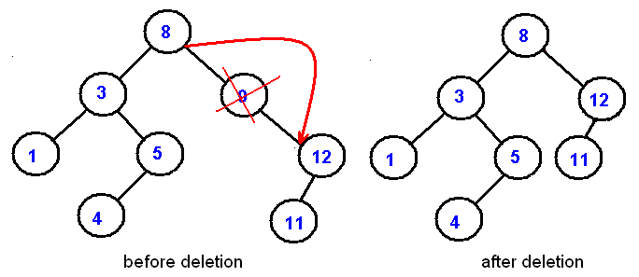
If toDelete is not in the tree, there is nothing to delete. If toDelete node has only one child the procedure of deletion is identical to deleting a node from a linked list - we just bypass that node being deleted

Slide 44
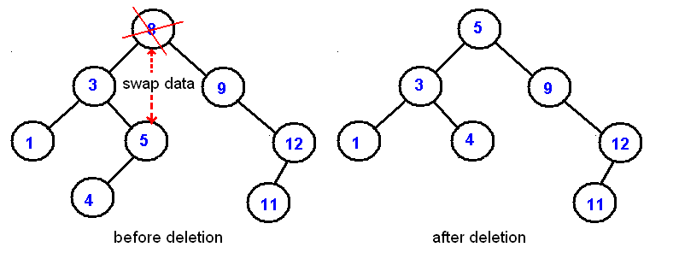
Deletion of an internal node with two children is less straightforward. If we delete such a node, we split a tree into two subtrees and therefore, some children of the internal node won't be accessible after deletion. In the picture below we delete 8:

Slide 45
Deletion starategy is the following: replace the node being deleted with the largest node in the left subtree and then delete that largest node. By symmetry, the node being deleted can be swapped with the smallest node is the right subtree.
For visualization of BST , click on the following link.

Slide 46
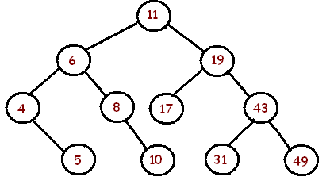
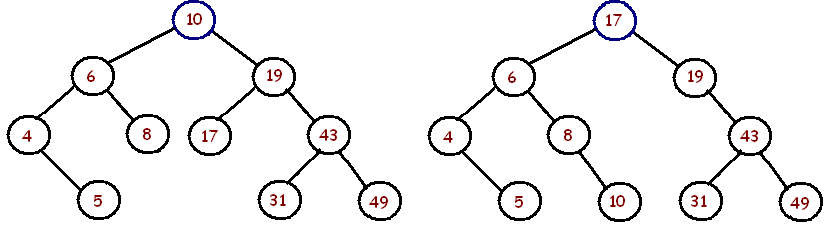
Exercise. Given a sequence of numbers:
11, 6, 8, 19, 4, 10, 5, 17, 43, 49, 31
A) Draw a binary search tree by inserting the above numbers from left to right and (B) then show the two trees that can be the result after the removal of 11.
A
B

Slide 47
FindMin
10
5
15
2
9
20
TreeNode min(Node T) {
if (T.Left == NULL)
return T;
else
return min(T.Left); }
7
17
30
How many children can the min of a node have?
Notes:
Every now and then everyone succumbs to the temptation to really overuse color.

Slide 48
Successor
Find the next larger node
in this node’s subtree.
  When it exists, it is the next largest node in entire tree
10
5
15
TreeNode succ(TreeNode T) {
if (T.right == NULL)
return NULL;
else
return min(T.right);
}
2
9
20
7
17
30
How many children can the successor of a node have?
Notes:
Here’s a little digression.
Maybe it’ll even have an application at some point.
Find the next larger node in 10’s subtree.
Can we define it in terms of min and max?
It’s the min of the right subtree!

Slide 49
Deletion - Leaf Case
Delete(17)
10
5
15
2
9
20
7
17
30
Notes:
Alright, we did it the easy way, but what about real deletions?
Leaves are easy; we just prune them.

Slide 50
Deletion - One Child Case
Delete(15)
10
5
15
2
9
20
7
30
Notes:
Single child nodes we remove and…
Do what?
We can just pull up their children.
Is the search tree property intact?
Yes.

Slide 51
Deletion - Two Children Case
Delete(5)
10
5
20
2
9
30
7
replace node with value guaranteed to be between the left and right subtrees: the successor
Notes:
Ah, now the hard case.
How do we delete a two child node?
We remove it and replace it with what?
It has all these left and right children that need to be greater and less than the new value (respectively).
Is there any value that is guaranteed to be between the two subtrees?
Two of them: the successor and predecessor!
So, let’s just replace the node’s value with it’s successor and then delete the succ.

Slide 52
Deletion - Two Children Case
Delete(5)
10
5
20
2
9
30
7
always easy to delete the successor – always has either 0 or 1 children!
Notes:
Ah, now the hard case.
How do we delete a two child node?
We remove it and replace it with what?
It has all these left and right children that need to be greater and less than the new value (respectively).
Is there any value that is guaranteed to be between the two subtrees?
Two of them: the successor and predecessor!
So, let’s just replace the node’s value with it’s successor and then delete the succ.

Slide 53
Deletion - Two Child Case
Delete(5)
10
7
20
2
9
30
7
Finally copy data value from deleted successor into original node
What is the cost of a delete operation ?
Can we use the predecessor instead of successor ?
Notes:
Ah, now the hard case.
How do we delete a two child node?
We remove it and replace it with what?
It has all these left and right children that need to be greater and less than the new value (respectively).
Is there any value that is guaranteed to be between the two subtrees?
Two of them: the successor and predecessor!
So, let’s just replace the node’s value with it’s successor and then delete the succ.
Cost = O(height(T))

Slide 54
Cost of the Operations
find, insert, delete :
Need to compute height(T)
For a tree T with n nodes:
  height(T) ≤ n
  height(T) ≥ log(n) (why ?)
time = O(height(T))

Slide 55
Height of the Binary Search Tree
Height depends critically on the order in which we insert the data:
  E.g. 1,2,3,4,5,6,7 or 7,6,5,4,3,2,1, or 4,2,6,1,3,5,7
7
4
1
6
2
5
2
6
3
4
4
3
1
3
5
7
5
2
6
1
7

Slide 56
Traversing the tree
There are mainly three types of tree traversals.
Pre-order traversal
Process data of root node
First, traverse left subtree completely
Then, traverse right subtree
Post-order traversal
Process data of left subtree
First, traverse right subtree
Then, traverse root node
In-order traversal
First process left subtree (before processing root node)
Then, process current root node
Process right subtree

Slide 57
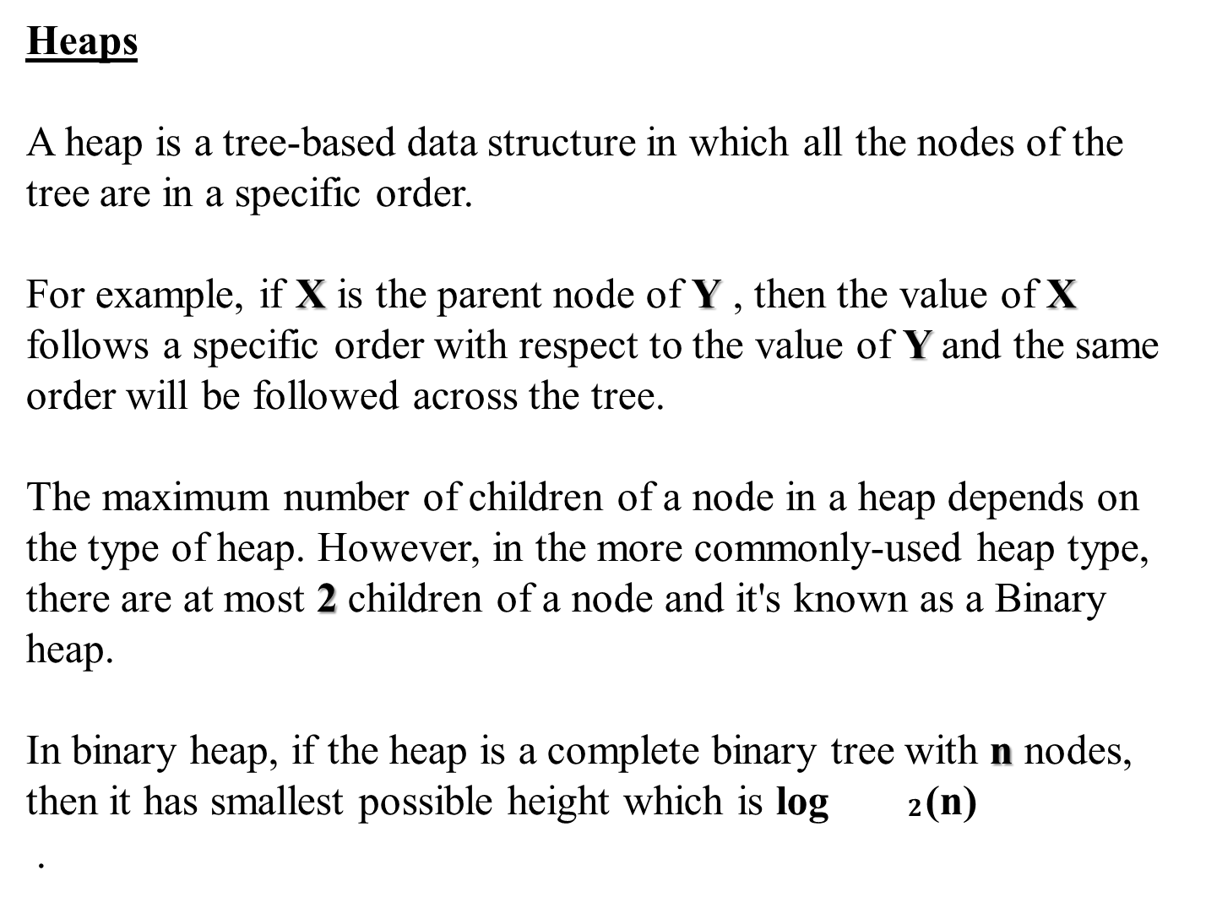

Slide 58

In the diagram above, you can observe a particular sequence, i.e each node has greater value than any of its children.

